Slide 1
OvS-DPDK Acceleration with rte_flow: Challenges and Gaps
December 10-11, 2019 | Westford, MA
Dr. Hemal V. Shah and Sriharsha Basavapatna, Broadcom Inc.

Slide 2
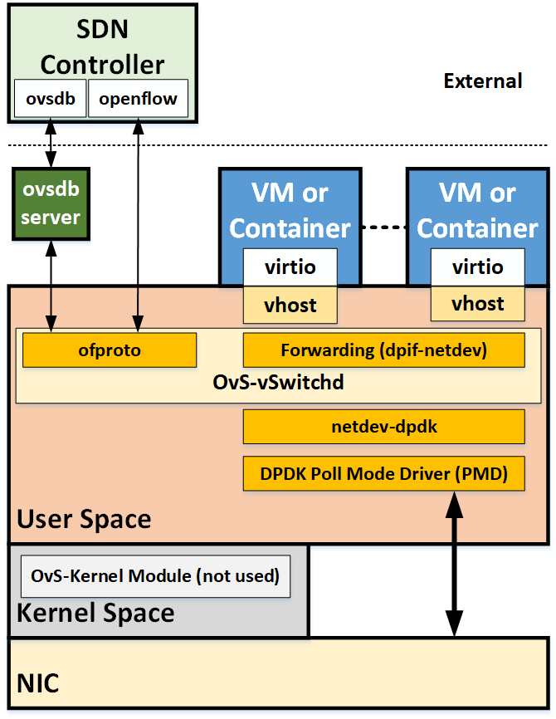
OvS-DPDK Acceleration Architecture Gaps
Offload capability – missing discovery
  rte_flow_validate: to validate a flow for offload
    Issues: extra operation, lack of specific error info
  OvS-DPDK does not even use rte_flow_validate
  Need to optimize design for capability discovery
Challenges with offload on vhost-user port
  Actions offload is not supported for ingress flows
  Software lookup is needed for egress flows
  Actions offload is also not supported for egress flows
DPDK VF Representor (VF-Rep) management plane
  CLI or management I/F – does not exist
  VF creation/destruction is outside of DPDK environment
    PF PMD can’t be used for VF management
  Vendor specific creation/destruction of VF-Rep
    A possible fix: dedicate a VF PMD for VF-Reps mgmt

Slide 3
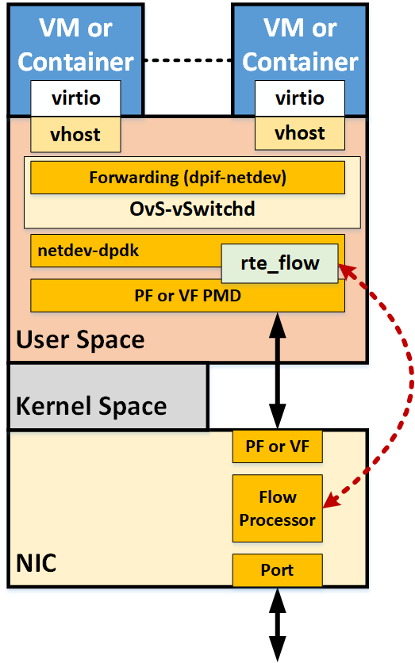
OvS-DPDK Acceleration Implementation Gaps
Actions Offload (partial and full)
  Supported: MARK, RSS
  Not supported: OUTPUT, DROP, COUNT, VF, ENCAP, DECAP, METER, etc.
Control Plane APIs
  Supported: Add, Delete
  Not supported: Dump, Flush, Stat
  Recent full offload patches try to address this
No error reporting for offloaded flows
  Need to refine

Slide 4
Other OvS-DPDK Offload Considerations
Dynamic Rebalance – does not exist, needed for capacity mgmt.
  Kernel and user/dpdk datapath differ w.r.t offloads
    kernel/tc : flow added to either DP or HW
    dpdk: flow added to both DP and HW
    Impacts dynamic rebalancing logic – need consistency
  Leverage Out-Of-Resources (ENOSPC) error reporting from PMDs
  Need error propagation from dpif-netdev back to ofproto-dpif
Openstack/OVN Integration …
Let us advance and improve OvS-DPDK acceleration/offload.

